Slide 1
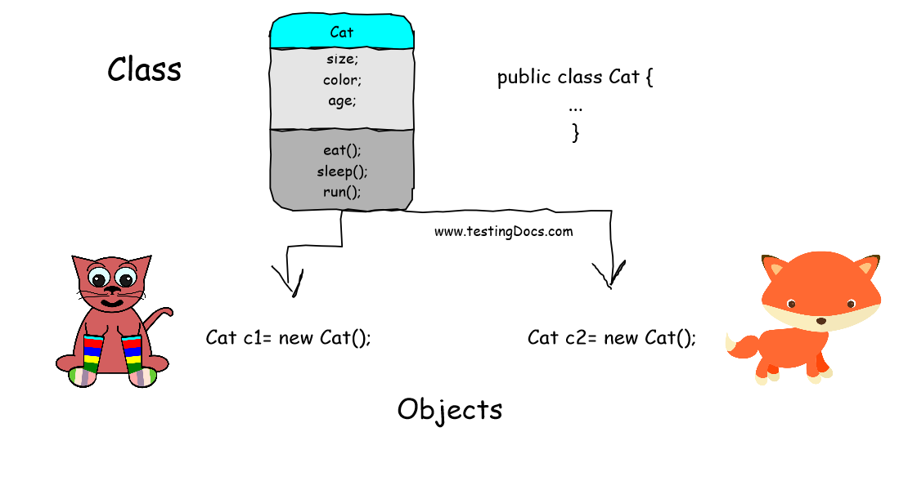
L02 Objects and Classes
teAch Bedeus LLC is licensed under a Creative Commons Attribution-NonCommercial-ShareAlike 3.0 Unported License

Slide 2
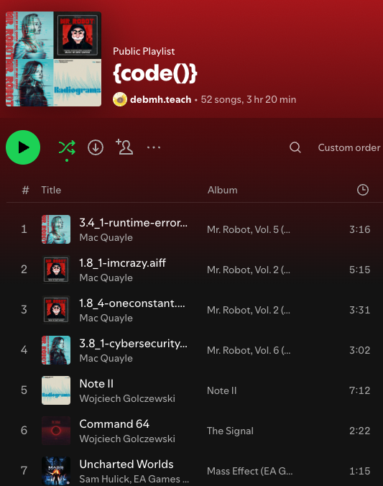
Check In
What music do you like to listen too when you are coding?
Open up today’s lecture
Survey? GE?
New Pairs
someone that had me pair with someone that didn’t
If you can’t find anyone that didn’t have me then
pair with someone you do not know
Goals:
Define and implement classes, objects, instance variables, and instance methods.
Apply encapsulation using access modifiers, constructors, and getters/setters.
If you are new to java please come see myself and Sayuj. It can be difficult at first but we can help you make the transition.
Notes:
https://admin.sli.do/event/7emwBJNernkKftdyZjkYri/polls

Slide 3

Build Community with CS²
A student-driven space dedicated to empowering you in computer science and cybersecurity. Our mission is to build a strong foundation for technical growth, innovative thinking, and career readiness — together. Feel free to email Deb Harding dhardi11@msudenver.edu if you want more information.
Upcoming Events:
Welcome Events
Tuesday August 26th 2:30-3:30 pm rm 295
Wednesday 27th 2:30-3:30 pm rm 240
Set Up Environment (Git/Github and IDE)
Sep 2, 2:15-3:15pm (AES 385)
Sep 3, 2:15-3:15pm (AES 490)
You can Join Discord https://discord.gg/Q56MjAA9p9
but you do not need to. You can just come to events.

Slide 4
Pre-Test
class SimpleCircle {
double radius;
SimpleCircle() {
radius = 1;
}
SimpleCircle(double newRadius) {
radius = newRadius;
}
double getArea() {
return radius * radius * Math.PI;
}
double getPerimeter() {
return 2 * radius * Math.PI;
}
void setRadius(double newRadius) {
radius = newRadius;
}
}
class, constructor, overload, instance methods, instance variables,
private, public, encapsulation, getters, setters
object, reference variable, instance
Memory, stack, heap
public class TestSimpleCircle {
/** Main method */
public static void main(String[] args) {
SimpleCircle circle1 = new SimpleCircle();
System.out.println("The area of the circle of radius "
+ circle1.radius + " is " + circle1.getArea());
SimpleCircle circle2 = new SimpleCircle(25);
System.out.println("The area of the circle of radius "
+ circle2.radius + " is " + circle2.getArea());
SimpleCircle circle3 = new SimpleCircle(125);
System.out.println("The area of the circle of radius "
+ circle3.radius + " is " + circle3.getArea());
circle2.radius = 100; /
System.out.println("The area of the circle of radius "
+ circle2.radius + " is " + circle2.getArea());
}
}

Slide 5
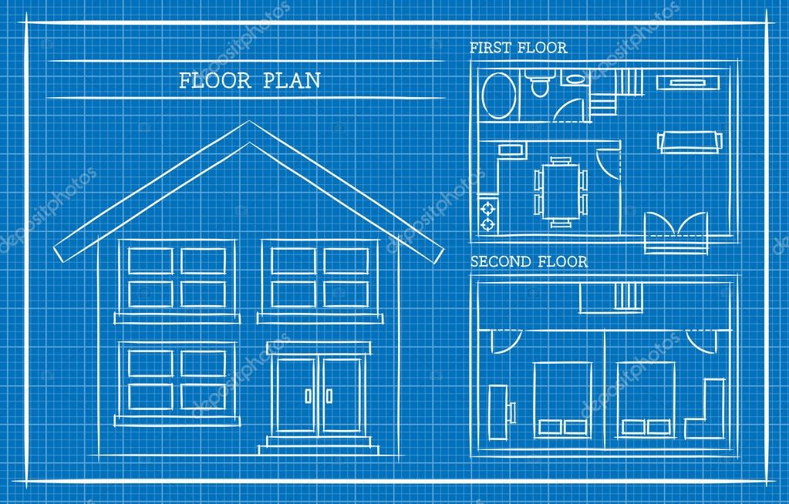



Classes and Objects
A class is a blueprint describing how to build something from the blueprint.
The blueprint is used to build similar houses
An actual house is built with the blue print
Each house can have different attributes
Color
Number of rooms
Garage Size
Counter tops
Many houses with same blueprint but different attributes

Slide 6
Why Objects?
Why Use Objects?
Objects are what we deal with in real life
Our mental model is to talk about objects - cars, dogs, houses, etc.
Helps us design in a more natural way! Matches our mental model.
Object State and Behavior
An object has two important pieces: state and behavior
State (Instance variables)
The data fields (properties/attributes) that define an object
Things an object knows!
A "dog" object may have properties such as breed, size, age, color, etc.
Behavior
The behaviors (methods) that operate on the object
Things an object does!
A "dog" object may have behaviors such as eat, sleep, sit, run etc.

Slide 7
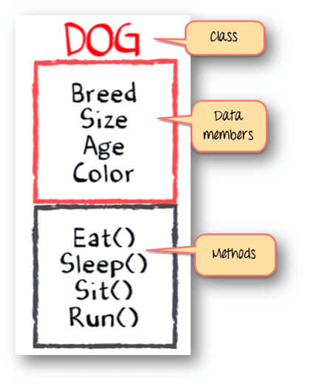
Classes
Classes are constructs that define objects of the same type.
Additionally, a class provides a special type of methods, known as constructors, which are invoked to construct objects from the class.
1. Class is a set of object which shares common characteristics/ behavior and common properties/ attributes.
2. Class is not a real world entity. It is just a template or blueprint or prototype from which objects are created.
3. Class does not occupy memory.
4. Class can have group of variables of different data types to define fields
5. Class can have a group of methods to define behaviors

Slide 8
Remeber
We've used predefined objects by doing the following:
Import the object’s class
Create an object from that class
Use methods defined for that class (find these in the class definition)
We've used the Scanner class to create a Scanner object
We create a Scanner object - below the object is named userInput
We do stuff with that object - like call methods - userInput.nextInt();
import java.util.Scanner;
public class Assignment2 {
public static void main(String[] args) {
// Create a Scanner object to read input from the user
Scanner userInput = new Scanner (System.in);
....
}
}
What is happening?

Slide 9


Scanner Class
Assign the reference variable the memory address on the heap
Constructor Constructs set the initial values for the class variables for this instance
Non-Primitive
Data Type - Class
Reference variable
new allocates memory on heap
.Operator used to access class method
Declare enough memory on the stack to store a memory address
Reference variable
Instance method

Slide 10
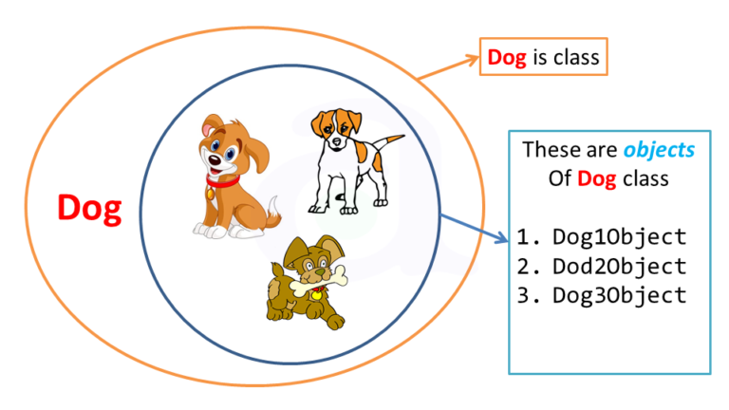
Object vs. Class
An object represents an entity like a car, house, circle, dog, etc
A class is used to construct an object that follows a blueprint
It defines an object’s attributes and behaviors
Just as you can create more than one building from a blueprint, you can create more than one object from a class
Class and Object in OOPs
One Class
Many Objects (instance of the class) that have same blueprint of the class

Slide 11
SimpleCircle Class Blueprint and Code
SimpleCircle
double radius String color
SimpleCircle() SimpleCircle(double radius, String color) getArea():double getPerimeter():double setRadius(newRadius: double): void
Class name like Scanner
Data fields: attributes (properties of a circle), instance variables
Constructors to construct object (no return values)
Behaviors: methods that act on object, instance methods
Run animation TestSimpleCircle.java and discuss before it goes to the next line of code what is in the next line of code that will run.

Slide 12
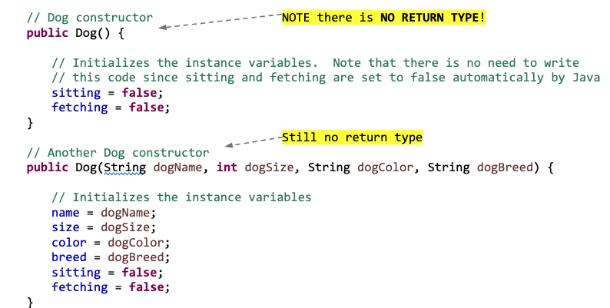
Constructors
Constructors can be used to initialize the data member fields

Slide 13
Constructors
A constructor has EXACTLY the same name as the class
A constructor can be overloaded: Can have multiple constructors that have different formal parameters
No return type is specified! Common error is to include void.
It is NOT necessary to write a constructor for your classes!
Generally, you will provide at least the no-arguments constructor - Dog()
If you don't - if you specify NO CONSTRUCTORS - Java automatically creates a default constructor
It takes no arguments
It has an empty body - no code
It does nothing to the instance variables

Slide 14
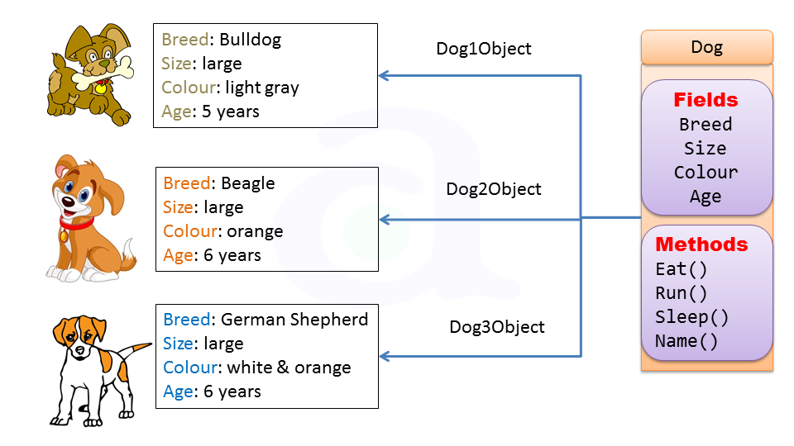
Instance Variables and Instance Methods
Instance Variable
A variable that is part of an instance of a class, (as opposed to a static variable that is part of the class itself).
State of an object - things an object knows about itself
Instance Method
A method that is part of an instance of a class
These methods can be executed only through a reference to an instance of a class
Behavior of an object - things an object can do
Instance variables and instance methods belong to each object’s specific instance

Slide 15
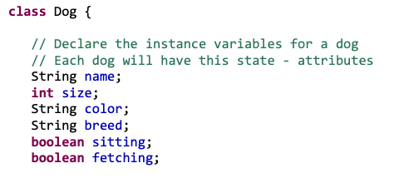
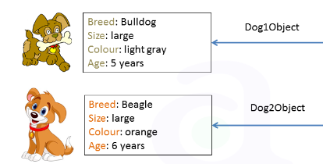
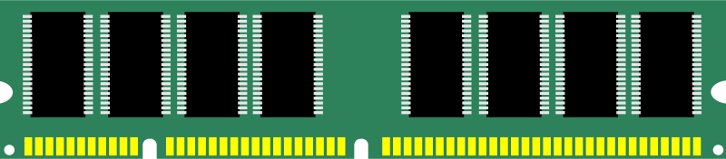
Instance Variables
In the Dog class the following are instance variables
These variables belong to each independent instance of the class and they are NOT SHARED
When constructed each dog object has its own values stored in the instance variables
name for myDog1 is independent from instance variable name for myDog2
myDog1.name is stored in a different memory location on the heap than myDog2.name
myDog1.breed
myDog2.name
“Bulldog”
“Beagle
0x7fff6771c324
0x7fff554566

Slide 16
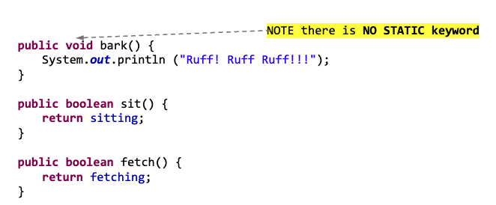
Instance Methods
Each dog will have it’s own bark, set and fetch behavior

Slide 17

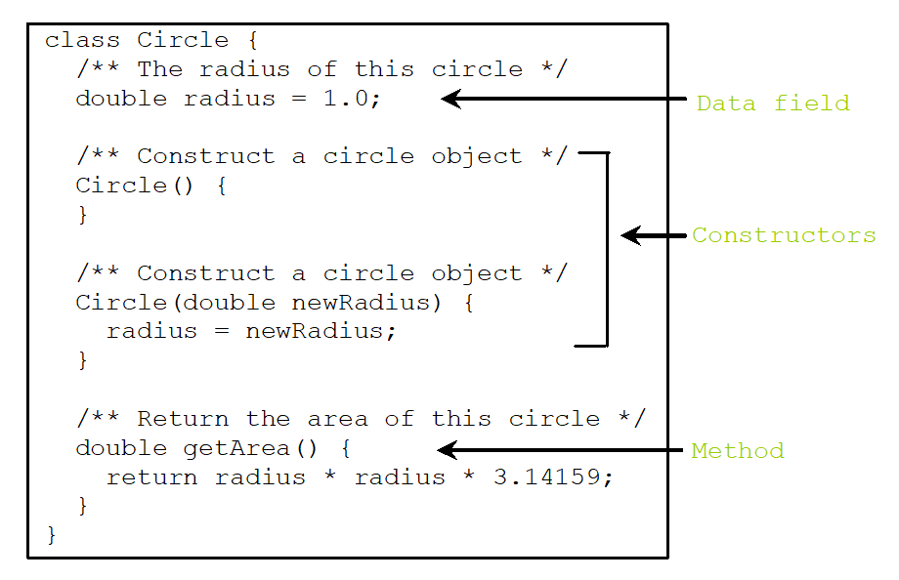
Creating Classes
We extend Java by creating classes – this class serves as a new data type!
The class could be created in a separate file but we are not going to do that.
No public keyword on class. Only 1 public class per file.
Data Field
Note that there is NO main method in this class
This class cannot be run
This class serves ONLY as a blueprint for Circle objects!
Each time a circle object is created, enough space is allocated in memory to hold the data members (fields).
No return type
Constructor
No return type
Has return type
Method

Slide 18
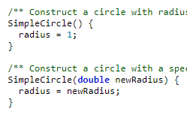
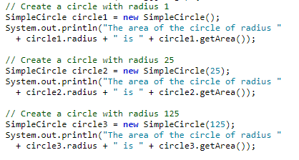
Examples
Remember how you create a Scanner object. The same needs to be done to create an object with the class you defined. Creating Objects: Creating an object (i.e. instance of a class) is called instantiation.
Match constructor based on parameters (constructor is overloaded)
Create circle object instance (reference variable using new operator and call the constructor
Class Name
Call method for that object using dot operator.
Get data field for that object using dot operator

Slide 19
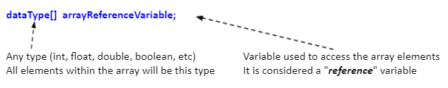

General Form of Reference Variable
For an array
ClassName objectReferenceVariable;
What happens in memory after this line of code is executed?
SimpleCircle circle1 = new SimpleCircle();

Slide 20

Declaring and Creating an Object: Memory
variable for declaring object is a reference variable
Identerfier numbers had a memory location holds null until new object created
SimpleCircle circle1;
Declaring datatype SimpleCircle as circle1 allocates memory on the stack to store the address to refer to where data members will be in memory on the heap. When not initialized it stores null.
circle1
null
009AFD30
New allocates memory on heap to store datamembers
SimpleCircle circle1 = new SimpleCircle();
Object variable circle1 now contains memory address on heap. The heap is not on the stack
0x7fff6771c324
radius = 1;
circle1
009AFD30
0x7fff6771c324
color= “blue”;

Slide 21
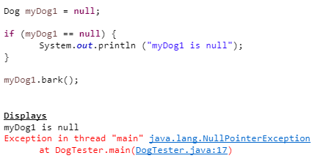
Reference Data Fields and the null Value
Data fields for an object can be any type
byte, int, short, long
float, double
boolean, char, String
reference - so an array or another object
Null
Special literal for reference types
Similar to true and false for boolean types
Default value for reference types
If you attempt to access a reference variable whose value is null you get a runtime null pointer exception. This means the reference variable can’t point to the address

Slide 22
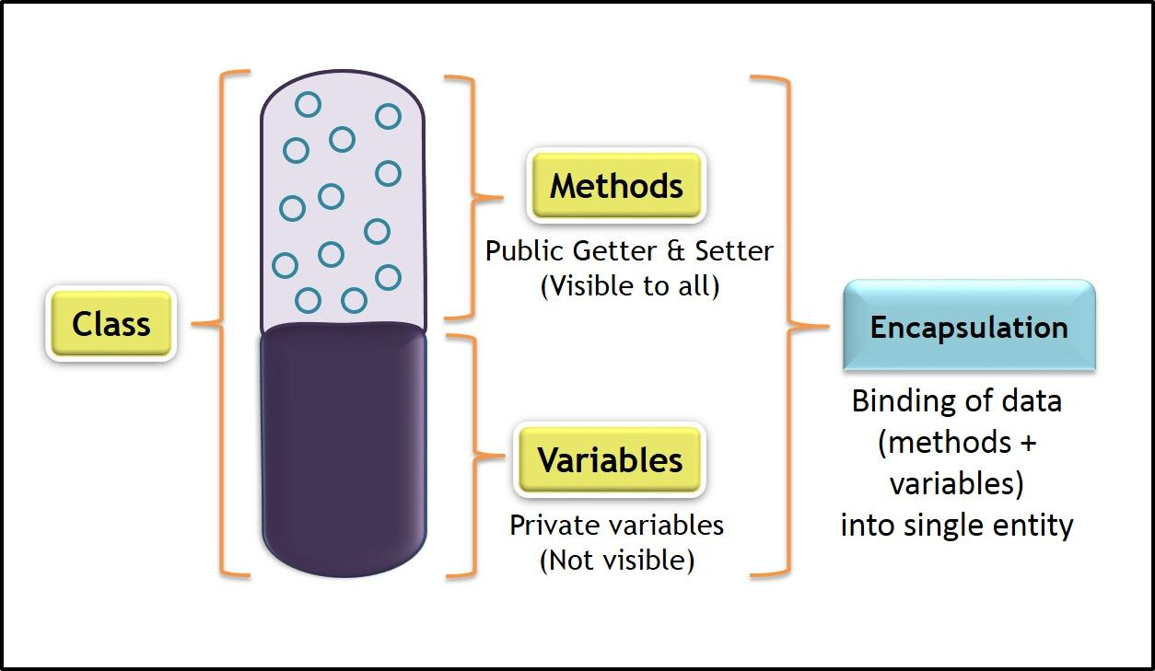
Using Encapsulation
Use encapsulation to hide the data within our classes. How do we do this?
Add the private modifier to all instance variables
Create getters and setters to retrieve and set private instance variables
getter - method that returns the value of an instance variable
setting - method that sets the value of an instance variable
Encapsulation is like a force-field around the instance variables in a class. Without encapsulation, the code is vulnerable to errors and hard to maintain.
Encapsulation in Java
Now what happens?
Private instance variables can no longer be accessed outside the class
The variables are hidden and accessible only within the class
User of class must use getter/setter to access/modify variable

Slide 23
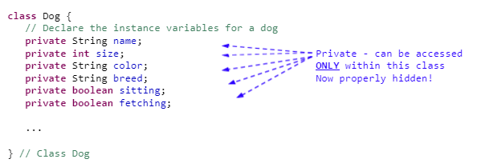
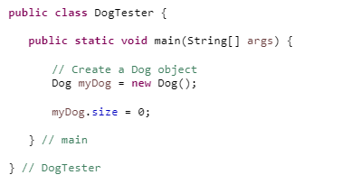
Hide All Data Fields (variables)
Make all data fields private.
Now if any code using this class and attempts to access a private variable a compiler error occurs
Compiler error is - "the field Dog.size is not visible"

Slide 24


Getters and Setters
So how do you access variable value and how do you set to a new value?
Provide getters (accessor) and setters (mutator) for private variables that need to be accessed outside of class. If the instance variable is only used inside class, no getter or setter is created.
General form of getter method
General form of a setter method

Slide 25
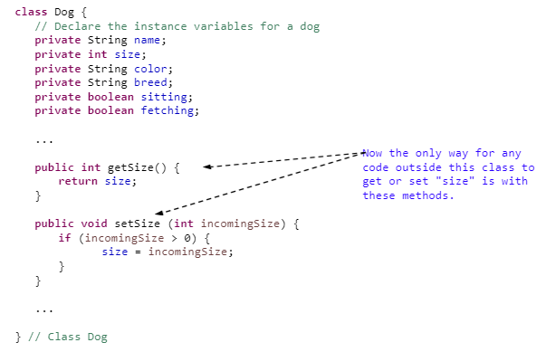
Create Getter and Setter Methods
I use getter and setter methods to help you understand and not call them accessor and mutator methods.

Slide 26
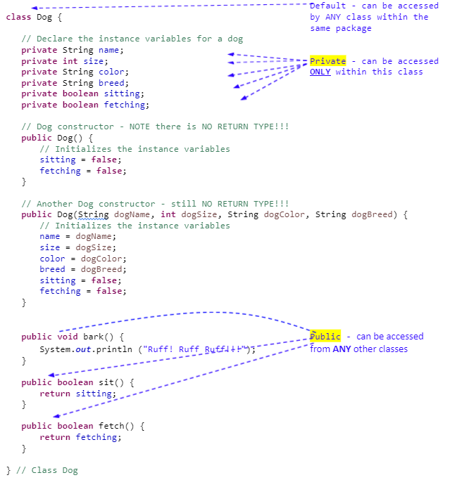
Examples
We will go into more detail on the modifier keywords in a future lecture
Public
Private
Protected
Default (Package-Private)

Slide 27
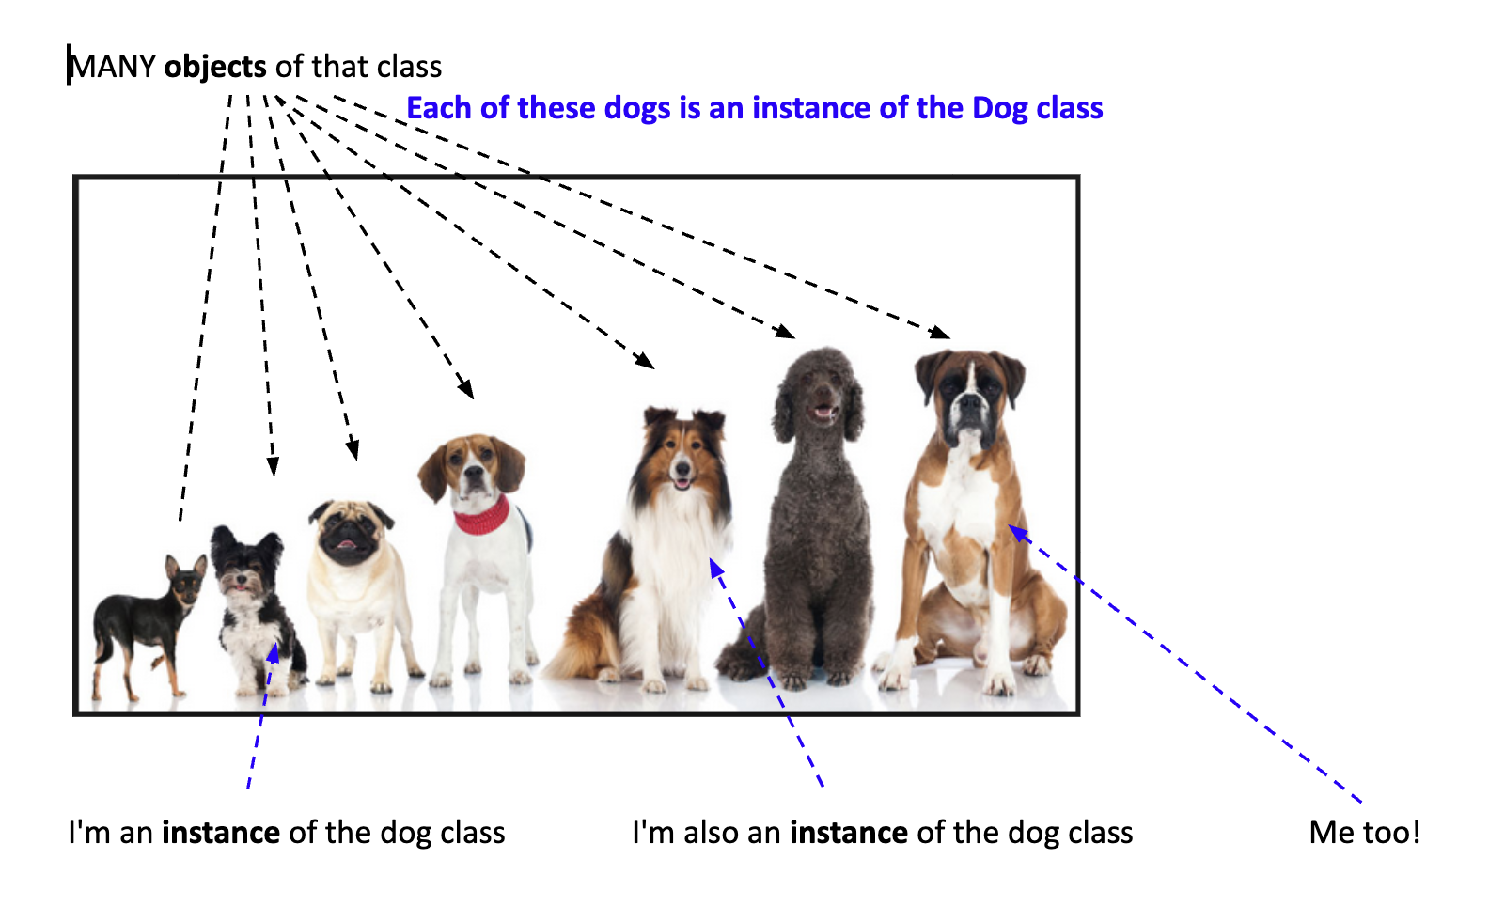
Classes and Object Terminology
Class: Used to construct an object – it defines an object’s attributes and behaviors – it’s the blueprint
Object: Represents of an entity like a car, house, circle, dog, etc.
Instance: An object of a particular class
Instantiation: When you create one instance of a class (i.e. object)
Constructor: A special “method” that is called when an instance of a class is created (no return type)
Reference Variable: A variable that stores a reference to address on the heap
Dot Operator: Operator used to access the data fields and methods of an object
Encapsulation

Slide 28
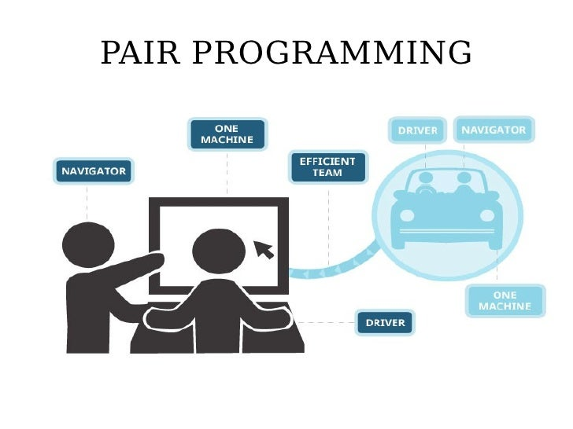
Pair Programming
What is Pair Programming?
Pair programming is a collaborative effort that involves a lot of communication. The idea is to have the driver and navigator communicate, discuss approaches and solve issues that might be difficult for a single developer to detect.
Setup:
One shared computer, alternate roles
Driver: Enters code
Navigator: checks the code being written
Effects:
Build collaboration skills
Fewer mistakes
Knowledge is shared to build understanding
It can be used in industry but i doesn’t mean every company uses it or it is used by a company all the time. It is best in specific situations.

Slide 29



Implement Encapsulation
// Define the circle class with two constructors
class SimpleCircle {
double radius;
/** Construct a circle with radius 1 */
SimpleCircle() {
radius = 1;
}
/** Construct a circle with a specified radius */
SimpleCircle(double newRadius) {
radius = newRadius;
}
/** Return the area of this circle */
double getArea() {
return radius * radius * Math.PI;
}
/** Return the perimeter of this circle */
double getPerimeter() {
return 2 * radius * Math.PI;
}
/** Set a new radius for this circle */
void setRadius(double newRadius) {
radius = newRadius;
}
}
Use one computer to pair program
Go to TestSimpleCircle example and copy the code
Go to Visualize Code select java from the drop down.
Paste your code and click visualization. Step through code and take turns explaining using the terms
Next click to edit the code and pass the computer for each P1 and P2. After a person updates code then run
P1: Implement encapsulation for the radius by hiding and then creating getter and setter methods
P1: Update main method to get and set the radius. RUN
P2: Create an instance variable called color to store the color of the circle such as “red”
P2: Update the second constructor to include initializing the color. Do the next step before running visualizer.
P2: Update the main method with constructing a circle by passing the radius and color.
Add a getter and setter

Slide 30
Implement Encapsulation
public static void main(String[] args) {
// Create a circle with radius 1
SimpleCircle circle1 = new SimpleCircle();
System.out.println("The area of the circle of radius "
+ circle1.getRadius() + " is " + circle1.getArea());
// Create a circle with radius 25
SimpleCircle circle2 = new SimpleCircle(25);
System.out.println("The area of the circle of radius "
+ circle2.getRadius() + " is " + circle2.getArea());
// Create a circle with radius 125
SimpleCircle circle3 = new SimpleCircle(125);
System.out.println("The area of the circle of radius "
+ circle3.getRadius() + " is " + circle3.getArea());
// Modify circle radius
circle2.setRadius(100);
System.out.println("The area of the circle of radius "
+ circle2.getRadius() + " is " + circle2.getArea());
}
// Define the circle class with two constructors
class SimpleCircle {
private double radius;
/** Return radius */
public double getRadius() {
return radius;
}
/** Set a new radius */
public void setRadius(double newRadius) {
if radius >= 0 {
radius = newRadius
}
else {
radus = 1;
}
}

Slide 31
Git/GitHub and IDE
Overview of Version Control and IDE (CS1050 and 2050 Java)
Try to set up git/github and your IDE so you can come see us if you need more help.
Git and Github Version Control
Setup Eclipse.docx - check in with me if you want to use a different IDE
Do not worry if you can’t get it to work or don’t understand it.

Slide 32
Technical Developer Documentation
Developer documentation helps people understand how a technologies work so you can build, use, or improve it.
Writing things down helps you keep track of how different technologies and tools were used — so you don’t forget later.
Makes it easier for someone new to understand the project and start working on it faster.
Sets clear rules and examples so everyone writes code the same way and reduces errors.
Good docs make it easier for others to use and build on your work.
When the answers are in the docs, people can help themselves.
Have you ever used websites, documentation or videos to help you learn or build something?
Do you have information from a previous class to help you when you can’t remember how to do something or what the terms mean?
Have you ever documented information to learn something and use in the future?

Slide 33
Best Practices for Developer Documentation
Be Concise by providing clear and simple explanations
Use short sentences, small paragraphs
Use lists and tables to organize information
Use standard industry terms but explain in simple language
Use Code Snippets and Visuals to reduce lengthy explanations:
Include examples you created
Include comments to describe parts of code
Include Screenshots, GIFs, Images
Include Resources that give steps or help explain concepts
Include website link with summary
Include links to videos with summary of content
Use of AI to help you learn
Ask questions to understand concepts better, give examples for it to explain in simple terms, ask for AI to provide different examples
Ask AI for resources such as What is a good website or video for a beginner using VSCode to edit HTML
Improve Developer Documentation
Be Concise When Writing
Avoid Using Technical Jargon
Be Sure to Include Code Snippets
Add Media to Your Documentation
First use the lecture information. Then use other Resources to help you.

Slide 34
Summary
Use the lectures as your first resource but here is a book you can also use
6.1. Anatomy of a Java Class
6.2. Writing Constructors
6.4. Accessor Methods (Getter methods)
6.5. Mutator Methods (Setter Methods)
6.6. Writing Instance Methods
Here is an example of Tech Doc starter for CS1050
Go to canvas and look at preparation and due dates
Come see us!
Look at our office hours.
Deb is in AES 200y and
Sayuj in Lounge or Virtually.
If you email me include the course number CS1050 in the title.

